Slide 1
WELCOME TO FINAL PRESENTATION Course Titel: E-commerce & Web Engineering lab
Course Code:CSE-0402 Presented By: Farhan Mashuk Saumik ID:UG02-46-17-005 Batch:46 Department of CSE State University of Bangladesh

Slide 2
Project Name:Portfolio

Slide 3
Features: ❑ Home ❑ About me ❑ Services ❑ Skills ❑ Contact ❑ Teams ❑ Portfolio

Slide 4
Introduction:
A portfolio website is a unique way to showcase your work and let others know about yourself

Slide 5
Languages & Tools
Language
HTML, CSS and JavaScript
Tools:
❑
Visual Studio Code
Apache
❑
❑ MySQL
❑ Apache

Slide 6
Benefits of Portfolio
❑ Flexibility
❑ Professional way to showcase my work
❑ Increase my visibility & online presence.
❑ It is present evidence of my relevant skills & abilities
❑ Portfolios are a great way to demonstrate thencompetencies.

Slide 7
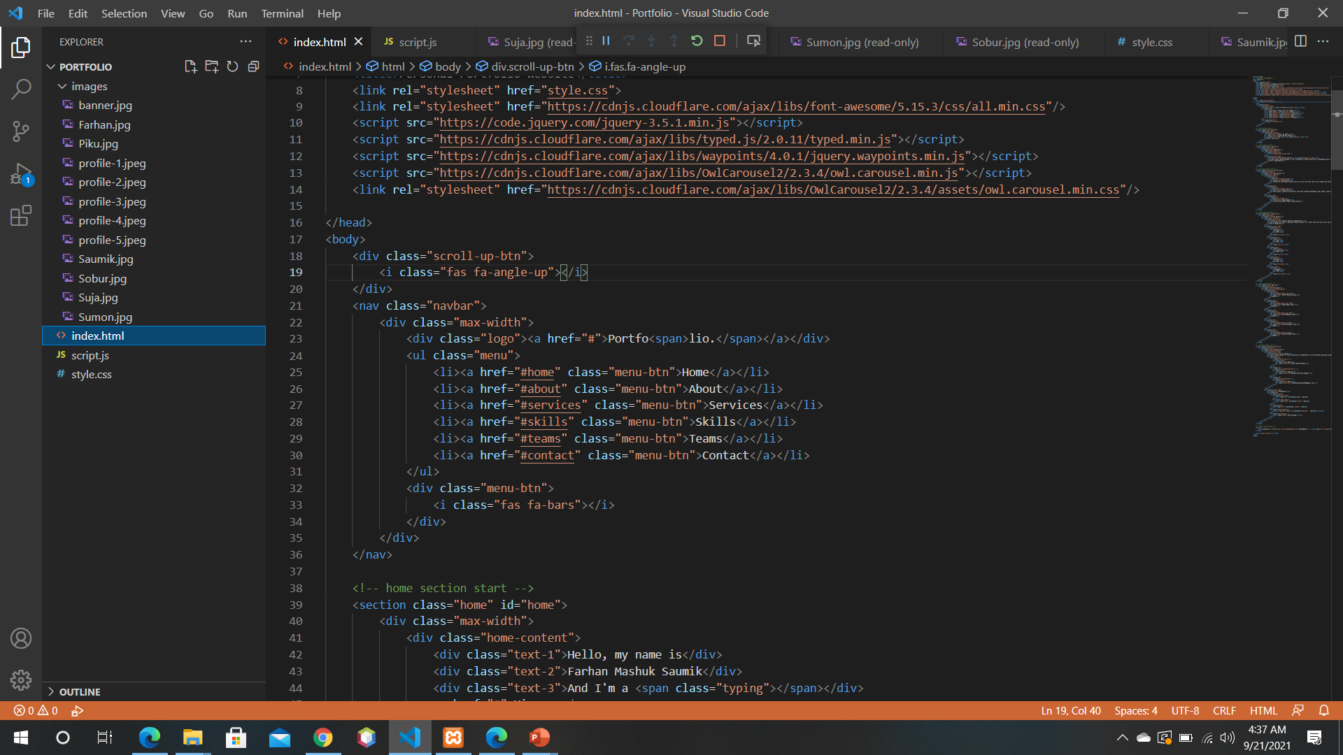
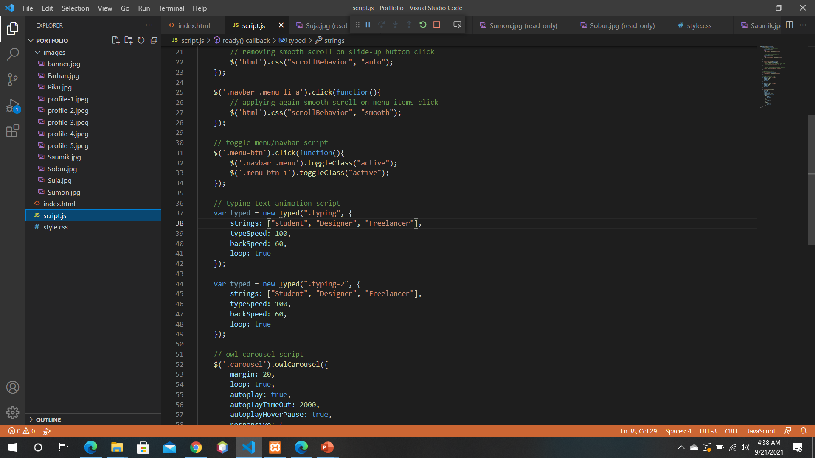
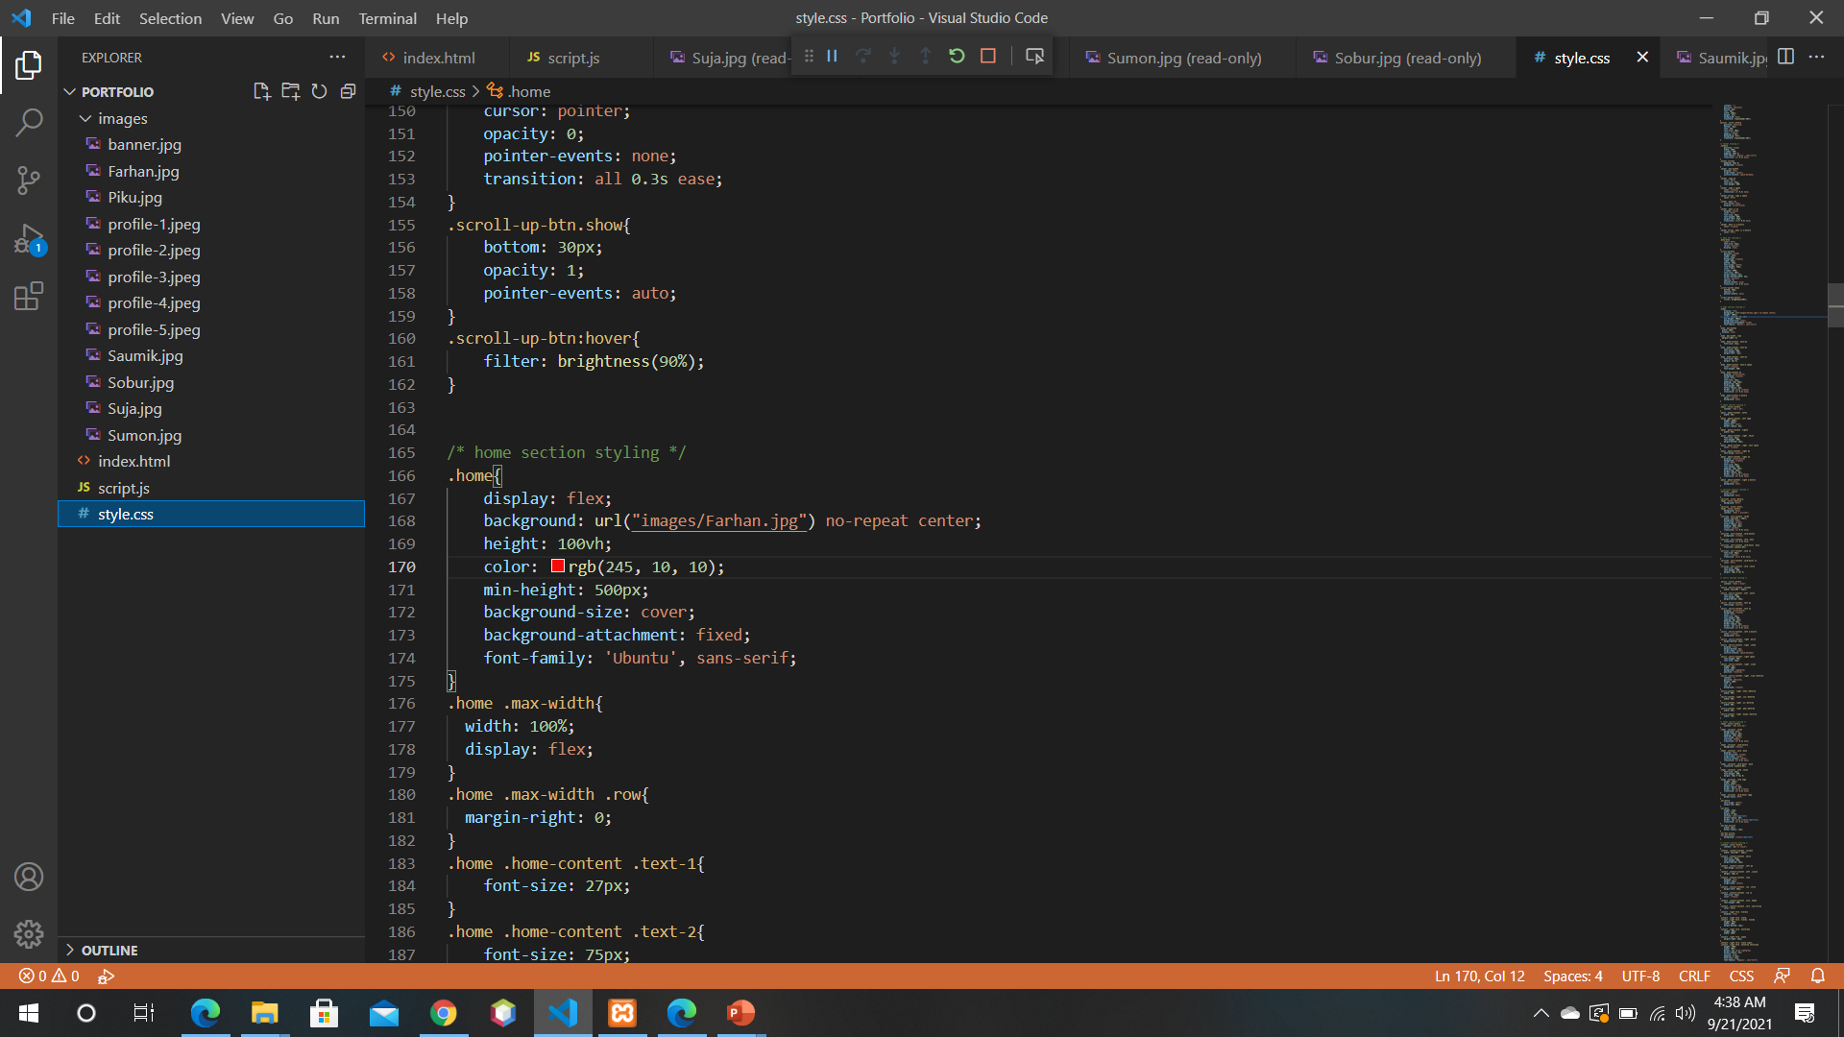
html,css & javascript code

Slide 8
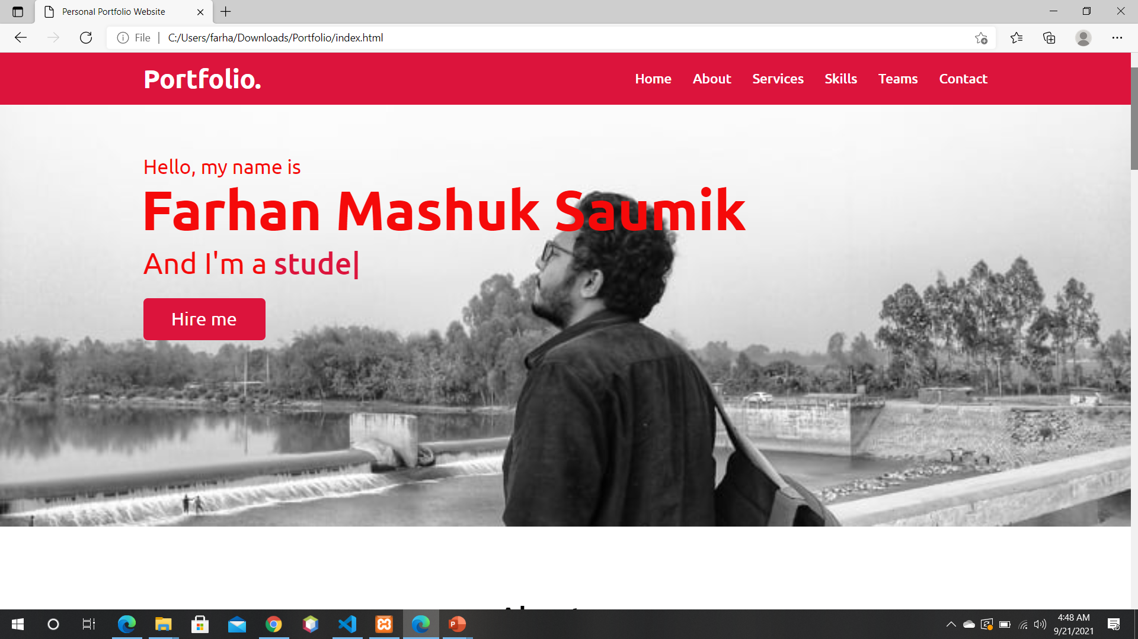
My Portfolio

Slide 9
Future Scope
❑ So in future, tell others about my skills and personality. Express my uniqueness through case studies.
❑ There are no rules and everything goes as long as i am able to make the visitor smile and remember me.

Slide 10
Conclusion
❑ A portfolio website lets me show off all of my work in one place.
❑ Take my personal portfolio website as an opportunity to surprise and impress my potential people.

Slide 11
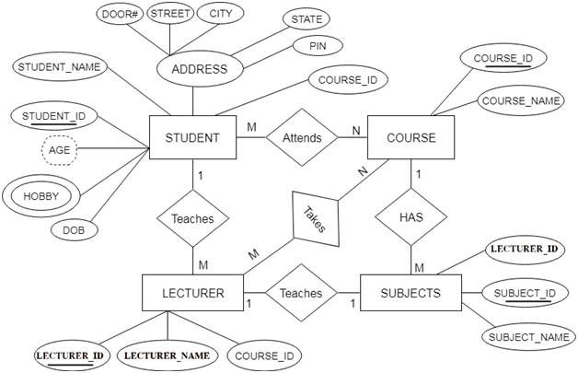
ER Diagram

Slide 12
Thank You

